Slide 1
Mental Health
How should the Church respond?

Slide 2
Can the Gospel message transform the “entire person” despite rising concerns of emotional unrest?

Slide 3
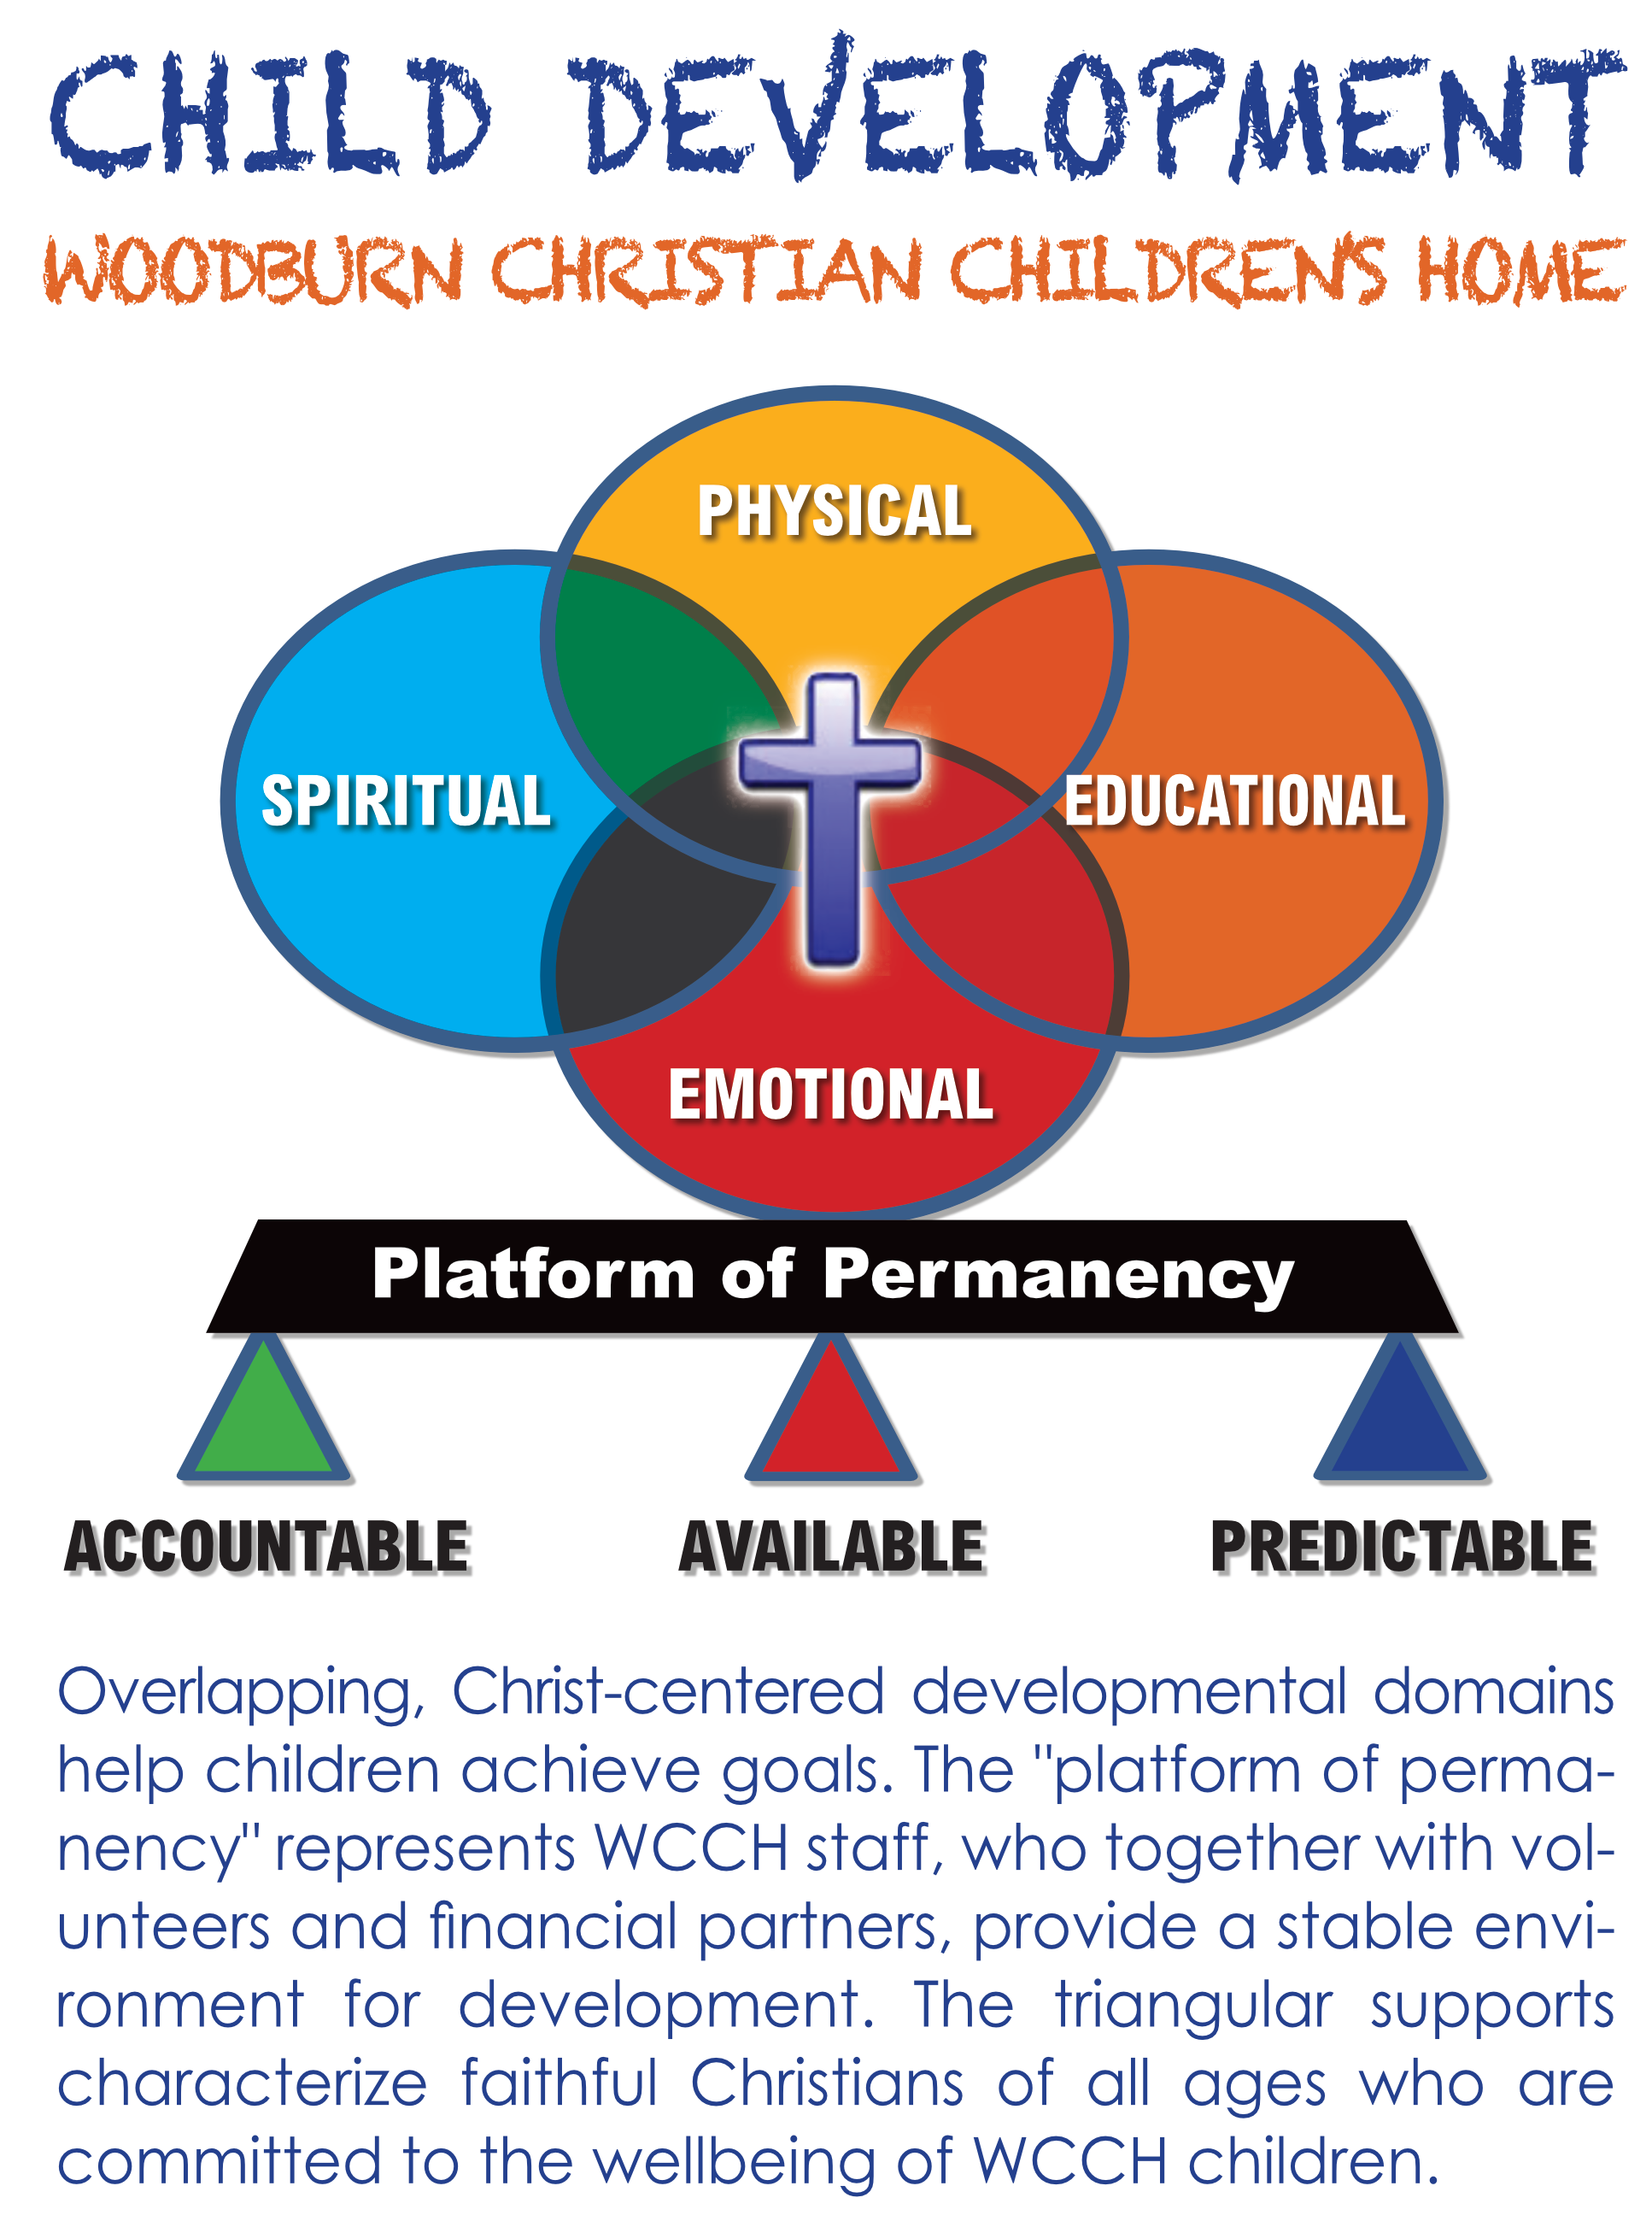
Can the Gospel message transform the “entire person” despite rising concerns of emotional unrest?
Within a biblical worldview, improved mental health is a privileged responsibility and goal of discipleship.
(SEE DIAGRAM)

Slide 4
Goal of Discussion
Two-Fold
Expand knowledge and understanding of “mental health” within a Biblical worldview.
Define, develop and apply.
Expand knowledge of common mental health “speed bumps” or barriers.
Anxiety and Depression

Slide 5
Define Mental Health
Mental health is a description of emotional/social well-being.
Well-being = security, safety, place to fit purpose, peace
Affects how we think, feel, act, relate, and make choices.
Influenced by faith: See Psalm 16:7-11, Romans 8:28-39, and 2 Corinthians 5:20-21.
Characteristics
Everyone has a “mental health score,” i.e. scale of 1-10.
Pastoral question: What dwells in you this day?
Mental health is communal.
Impacts others and is impacted by others.
See Philippians 2:1-18
Emotionally healthy church is the goal.
Influenced by Faith (preferably Christian faith).
Origin, purpose, ethics, evil, and death.
See Genesis 1-3 (foundations of faith and identity).

Slide 6
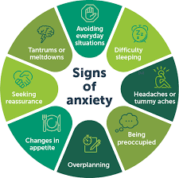
Anxiety
Defined:
A mental condition characterized by excessive apprehension (worry, fear, dread) about real or perceived threats, typically leading to avoidance behaviors and often to physical symptoms.
Fear: primary emotion. Worry: control-based.
Characteristics
Anxiety conditions can be temporary or permanent.
Perceived threat causes change in “status quo.”
Deviates (+/-) from baseline to excessive.
Lower baseline over time (Bible study and support from Christian Community). See Matthew 6.
Anxiety has an emotional and physical voice.

Slide 7
Managing Anxiety
Three Common Anxiety Disorders
Generalized Anxiety Disorder
Persistent and uncontrollable anxiety/worry (most days during 6-month period).
Restless, aggression, fatigue, sleep disturbances, and problems concentrating.
Separation Anxiety Disorder
Classic anxiety disorder of childhood.
Makes child prone to anxiety disorder in adolescence and early adulthood.
Typically recover at the age of 4-5 years (if not integrated, continues into adulthood).
Social Anxiety Disorder
Starts as early as 8 years old.
Approximately 75% of people experience symptoms between the ages of 8-15 years.
Everyday interactions cause significant anxiety, self-consciousness and embarrassment.
Leads to avoidance behaviors.
Scriptural Examples
Jesus (Luke 22:39-46), Martha (Luke 10:40-42), Jonah, Mordecai and Esther (Book of Esther).
Prophets (Isaiah, Jeremiah, Ezekiel, and Daniel).

Slide 8
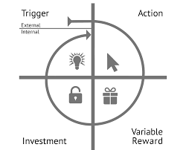
Managing Anxiety
Cognitive Behavioral Therapy (CBT) = Christian Discipleship
Modify thinking
Fundamental tenet of CBT is that cognition is essentially the source of feelings and behavior..
Pastoral Goal: Discover distorted and anxiety-provoking thoughts.
Reconstruct and strengthen thoughts about oneself and “God-world.”
Learn coping skills (prayer, fasting, serving, study, silence, etc.)
Matthew 5-7, Romans 12-15, John 8:31-38, Book of James
Christian Community Contribution
Encourage independence versus overprotection (avoid toxic charity).
Accept and support verse criticize or reject.
Use preaching calendar as a pathway of mental health development.

Slide 9
Depression
Defined:
A mental condition characterized by persistent “sadness” and lack of interest or pleasure in previously rewarding or enjoyable activities.
Sadness is an emotional pain associated with, or characterized by, feelings of disadvantage, loss, despair, grief, helplessness, disappointment and sorrow.
Persistent (everyday) for at least two weeks (distinguish sadness from depression).
A soul-sickness.
Characteristics
Tiredness, poor concentration, changes in appetite/interests, increased hopeless/anger.
No longer participating in worship, study and volunteer activities.
More women are affected by depression than men.
Depression can lead to suicide.
Causes include childhood adversity, loss, brain chemistry, genetics, medical conditions.
Single episode (situational), recurrent depressive disorder, and bipolar disorder.

Slide 10
Managing Depression
Four Common Types of Depression
Single Episode
Connected to a specific event, or season of life (Acts 27-28).
Triggered by performance, relational change, moving, death of loved one, or divorce.
Seasonal Affective Disorder (SAD)
Short days and less daylight triggers a chemical change in the brain.
Recurrent (persistent) Depressive Disorder (clinical depression)
The person has a history of at least two depressive episodes.
Chemical imbalance producing intense feeling of loneness and hopelessness.
Bipolar Disorder
Depressive episodes alternate with periods of manic symptoms, which include euphoria or irritability, increased activity or energy, and other symptoms such as increased talkativeness, racing thoughts, increased self-esteem, decreased need for sleep, distractibility, and impulsive reckless behavior.

Slide 11
Managing Depression
Management and Treatment
Family’s lifestyle is important.
Intentionality
Family System Influence
Children playback family’s emotions.
Focused attention on Christ.
Faith is the rallying point.
Seek Professional Help
Partner - Alongsider

Slide 12
Conclusion
Mental Health is a scaled-score (like a pain scale): 0 – 10.
Family backdrop is very important to consider.
Faith in Jesus the Christ creates a “fertile field” for emotional health.
Biblical teachers and preachers should include mental health development as part of the “actionable responses” to sermons and lessons.
Today’s material is the “tip of the iceberg.” Discover more about the “speedbumps.”
Recommended Reading
The Emotionally Health Church, Peter Scarrero,
Healthy Congregation (and) Congregational Leadership in Anxious Times, Peter Steinke
Congregational Fitness, Denise Goodman
Perspectives on Congregational Leadership, Israel Galindo

